Slide 1

Project Title –Netflix Data Analysis
Vedant Ingle
INTERNSHIP_17546440516895be537820f

Slide 2

PROBLEM STATEMENT
Netflix has become one of the most prominent global streaming platforms, continuously expanding its library with a mix of original productions and licensed content. However, with growing competition from platforms like Amazon Prime, Disney+, and regional OTT providers, Netflix must strategically analyze its content catalog to identify strengths, gaps, and opportunities.
The specific problem to be addressed in this project is 'Content Trends Analysis for Strategic Recommendations'. The aim is to uncover how Netflix’s content distribution (Movies vs. TV Shows, genres, and country contributions) has evolved over the years. This will enable the identification of key genres, audience preferences, and strategic insights into global content expansion.

Slide 3
Project Description
The Netflix Data Analysis Project aims to explore and analyze the content available on Netflix to uncover meaningful insights and viewing trends. Using a real-world dataset, this project focuses on understanding the distribution of Movies and TV Shows, their release trends over the years, genre popularity, and country-wise contributions to the Netflix library.
The analysis is performed using Python in Google Colab, leveraging libraries like Pandas, NumPy, Matplotlib, and Seaborn for data cleaning, manipulation, and visualization. Through this project, we identify patterns such as how Netflix’s content production has evolved over time, which genres dominate the platform, and how Movies vs TV Shows differ in growth and availability.

Slide 4

WHO ARE THE END USERS?
The insights generated can be useful for:
Netflix content strategy teams – to plan acquisitions and productions.
Data analysts and business strategists – for OTT content trend evaluation.
Media researchers and marketers – to study audience preferences.
Students and educators – as a case study in data analytics.

Slide 5

Technology Used
Python
Pandas
Google colab
Matplotlib & Seaborn
Numpy
CSV dataset

Slide 6
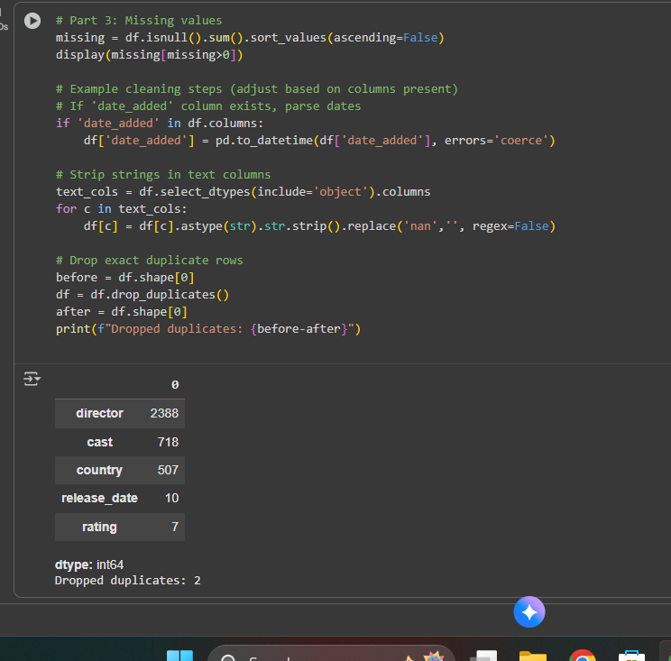
RESULTS1

Slide 7
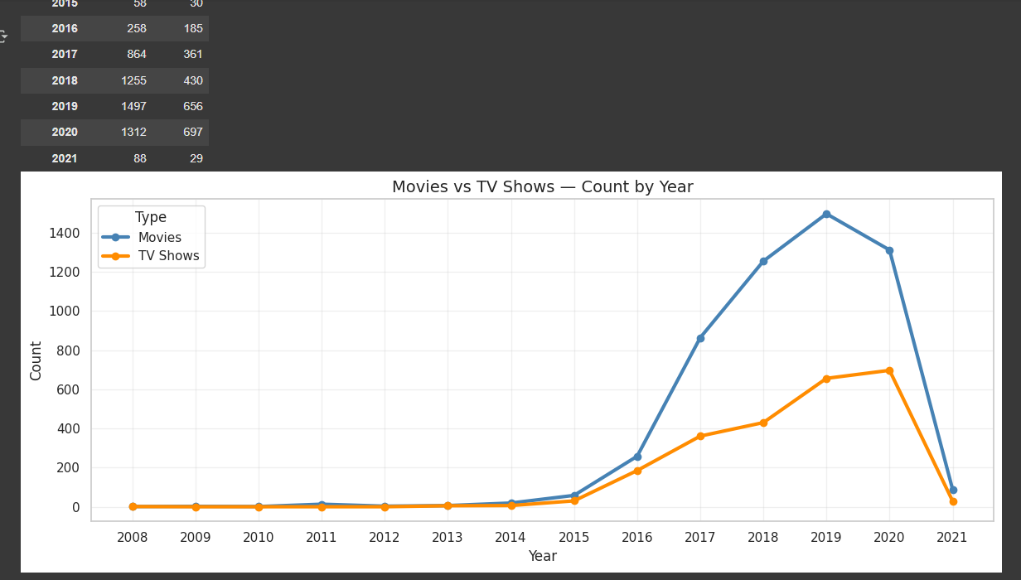
RESULTS2

Slide 8
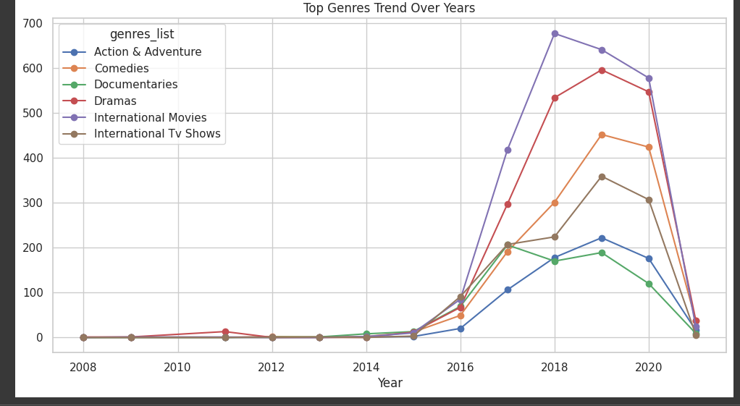
RESULTS3

Slide 9
GitHub repository
https://github.com/vedantingle123/Netflix_Major_Project_Vedant_Ingle

Slide 10
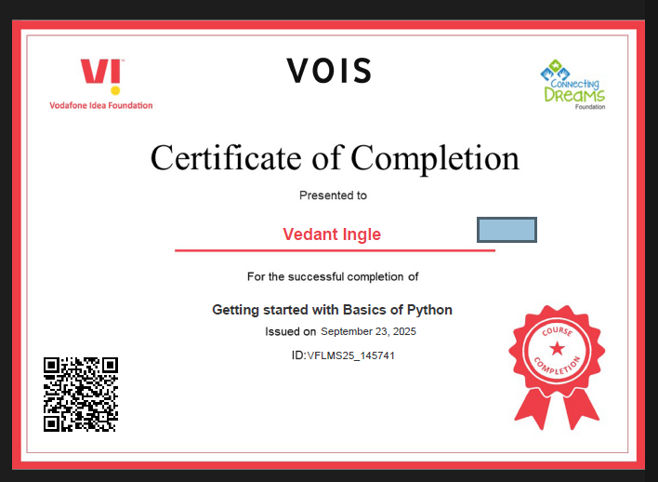
Getting started with Basics of Python Certificate

Slide 11
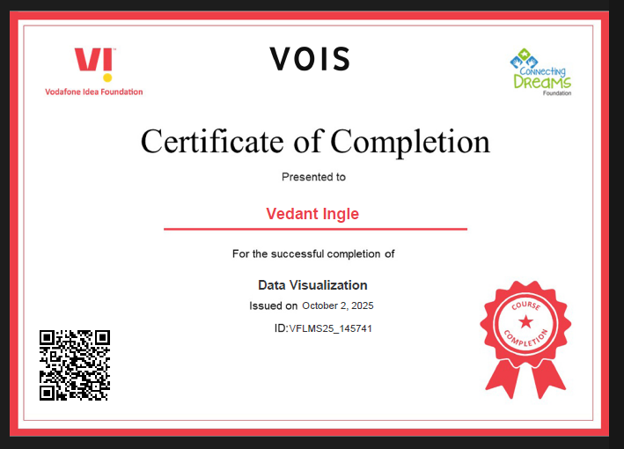
Data Visualization Certificate

Slide 12
Thank you
.
.

